Slide 1
GOOGLE DATABASE HACKING!

Slide 2
Google Hacking
Google hacking is a term that refers to the art of creating complex search engine queries in order to filter through large amounts of search results for information.

Slide 3
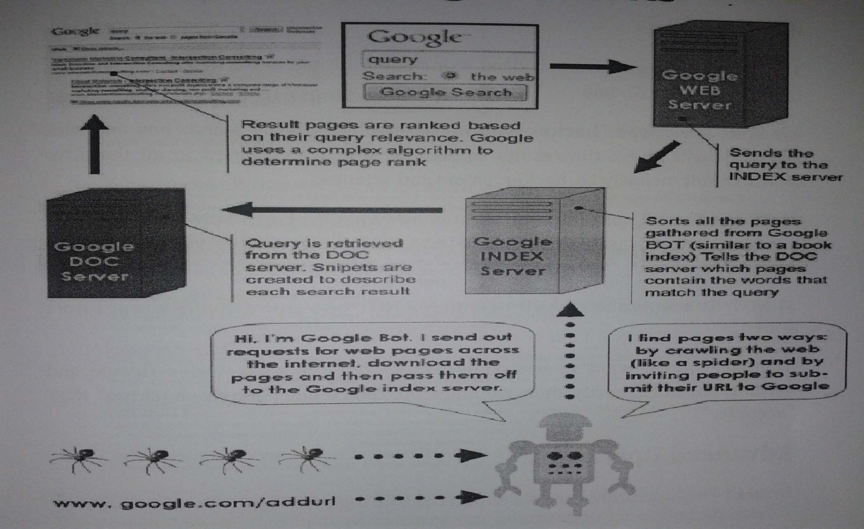
How Google Works

Slide 4
Google Operators
Operators are used to refine the results and to maximize the search value. They are your tools as well as Hackers” Weapons
Basic Operators +, -, ~, ., *, “”, |, OR

Slide 5
Advanced Operators
allintext: *allintitle:
allinurl: *cache:
define: *filetype:
Info: *intext:
Intitle: *inurl:
link: *phonebook:
related: *site:

Slide 6
Google Hacking
Basic operators
1) And [+] : This operator is used to include multiple terms in a query which is to be searched in Google. Example: If we type “hacker+yahoo+science” in Google search box and click search, it will reveals results something which are related to all the three words i.e. hacker, yahoo, science

Slide 7
Google Hacking
2) OR [ | ] : The OR operator represented by symbol ‘|’ or simply the word OR in uppercase latters, instructs Google locate either one term or another term in a query.
3) NOT : It is opposite of AND operator, a NOT operator include a word from search. Example : If we want to search a websites containing the terms Google and Hacking but not security then we enter the query like “google+hacking” NOT “security”.

Slide 8
Advanced Operators
Intitle:password
Inurl:/admin/login.asp
Inurl:administrator
Inurl:admin filetype:asp inurl:userlist
Site:www.iihtjaipur.com
Info:www.certifiedethicalhacker.com
Define:security

Slide 9
Advanced Operators
Inurl:gov.pk filetype:xls
Filetype:doc
Inurl:/view/index.shtml (sever-passed html)
Inurl:8080
“vnc desktop” inurl:5800
Intitle:”curriculum vitae”
Intitle:index.of.admin
Inurl:”nph-proxy.cgi” “start browsing”

Slide 10
Security Against Google Hacking
The Robot Exclusion Standard, also known as Robot Exclusion Protocol or robots.txt protocol.
Robots.txt is a file which spiders read to determine which part of website they may visit or may not visit.
A text file in root directory to restrict search engine spider’s access to certain file or folders of a website.

